Slide 1

Social and economic relevance of rainfall
Christian Kummerow
CIRA
Colorado State University
Feb. 28, 2014
Global Precipitation Mission

Slide 2
Precipitation Products
Climate – Highest possible quality, unbiased sampling with associated uncertainty.
Weather – Frequent, high resolution measurements with associated uncertainties.
Notes:
A short tour of methods to help explain why results are.

Slide 3
Satellite Sensor/Retrieval Methods
Single Sensor Approaches
Rain gauges (as early as 1000 BC)
Infrared (GPI/OLR)
Microwave Sounding Radiometers
MSU → AMSU → ATMS → MHS → SAPHIR
Microwave Window Radiometers
SSM/I → TMI → AMSR → WindSat → SSMIS → GMI
Precipitation Radar
TRMM PR → CloudSat → GPM DPR
Merged (Multi-platform) Approaches
Weather: CMORPH, TMPA, GSMAP, PERSIANN, GPM-IMERG
Climate: GPCP, CMAP
Notes:
A short tour of methods to help explain why results are.

Slide 4
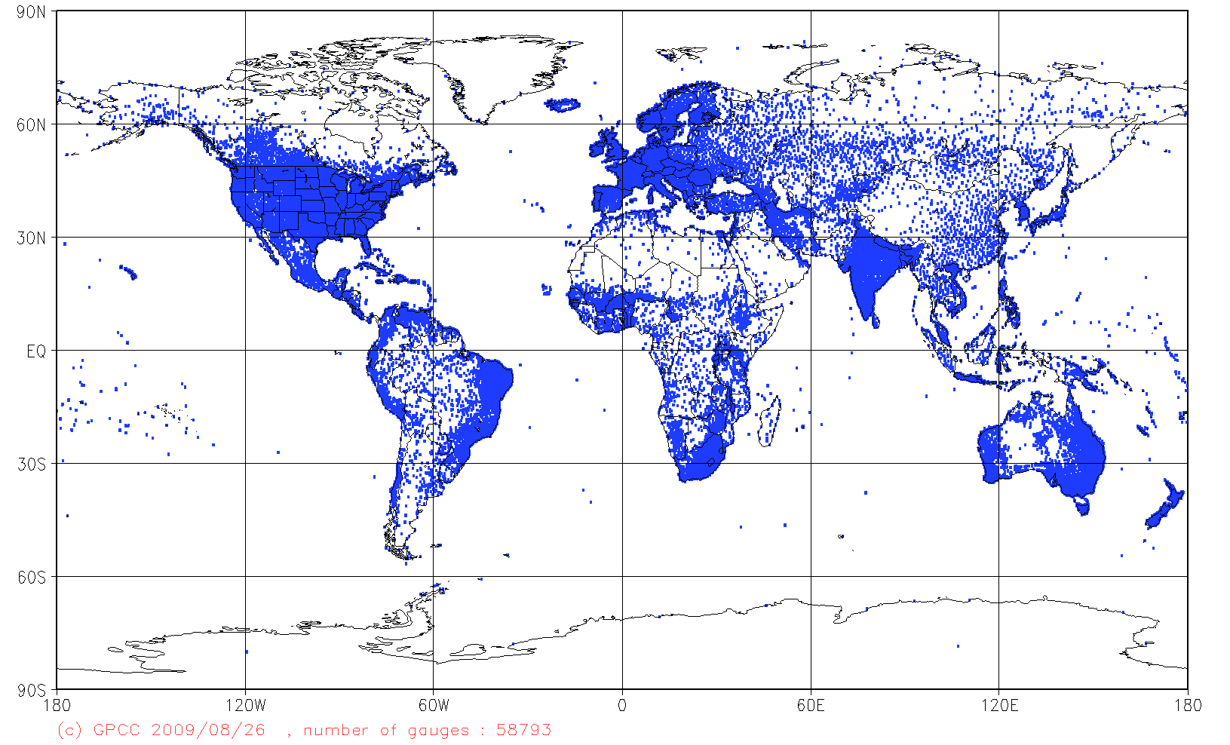
Rain Gauge Data Bases

Slide 5
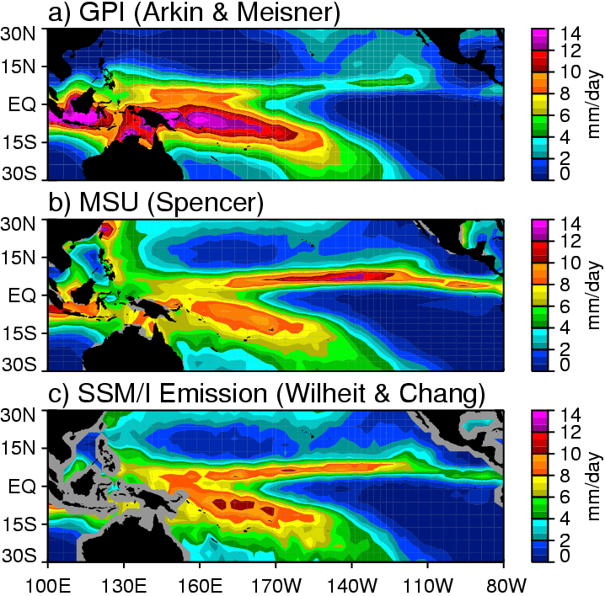
Satellite Rainfall Biases
Mean DJF Rainfall (1987 – 1996)
Notes:
Not random and not bias. A regional and seasonal phenomenon.

Slide 6
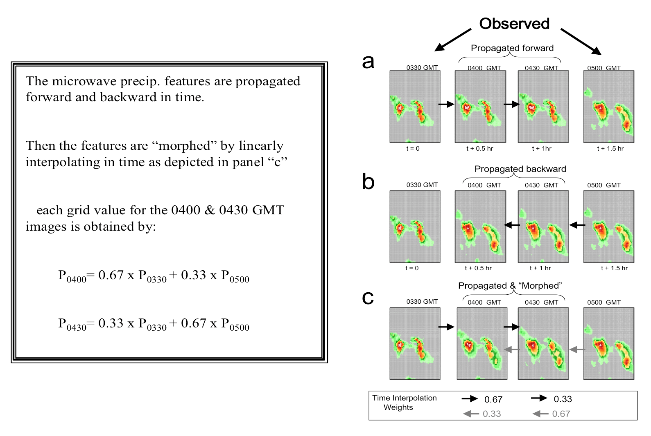
CMORPH
Notes:
Not random and not bias. A regional and seasonal phenomenon.

Slide 7
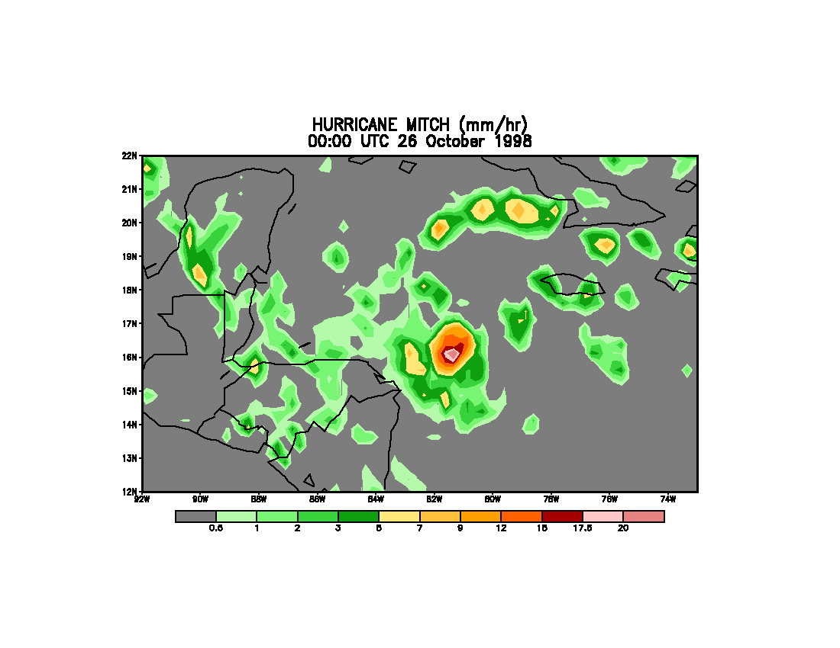
CMORPH Rain Rates

Slide 8
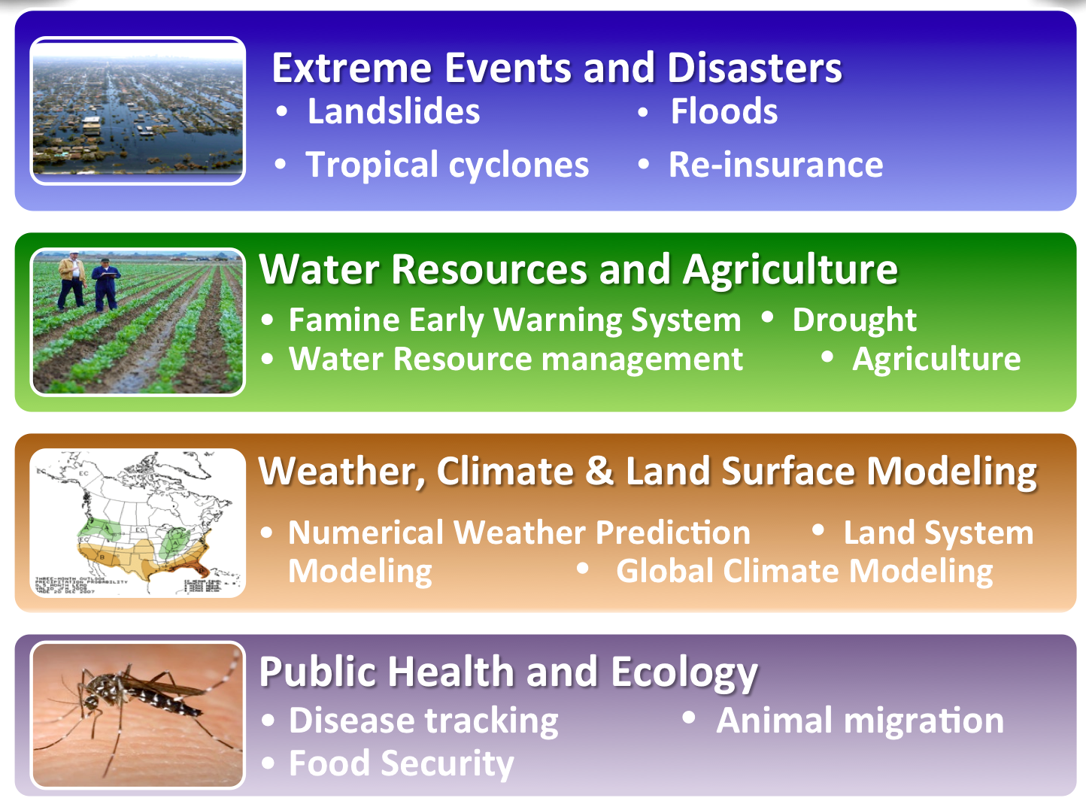
Societal Benefit Areas
Notes:
Talking points:
GPM provides an example of how we work with interagency and other partners to facilitate use of data in decision-making and forecasting– in this case it provides information of use to water resource managers or emergency responders who require information about precipitation.
These are just a selection of the many societal applications where TRMM data has already been used and GPM data will expand and improve these applications

Slide 9
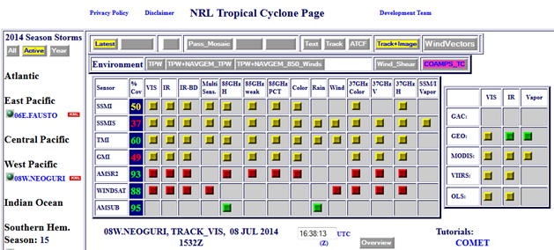
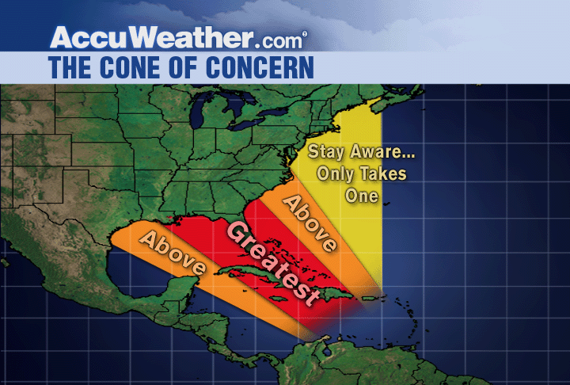
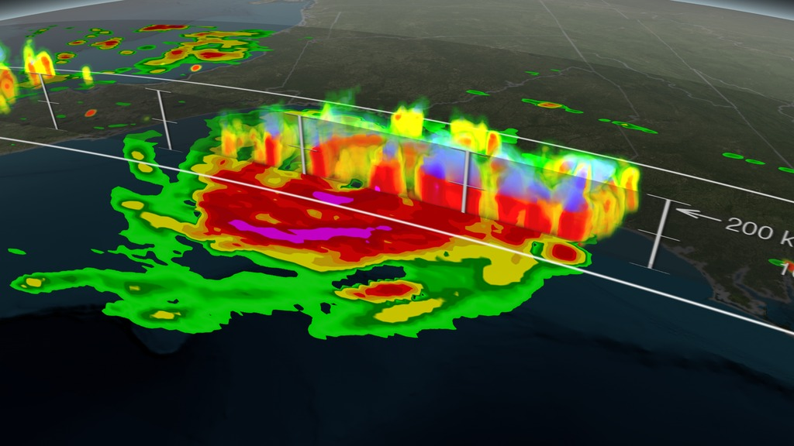
Severe Storms
Precipitation observations are in use at NRL, ECMWF, NCEP, JMA, and other NWP centers to improve weather forecasting through assimilation of Level 1 and Level 2 data
GMI/DPR image of Hurricane Arthur as it moved northwards on July 3rd, 2014. Both heavy rain (green and red colors) near the Earth’s surface and ice aloft (blue) can be observed as the storm intensifies.
Notes:
In 2004, more than 600 tropical cyclone fixes were made using TRMM.

Slide 10
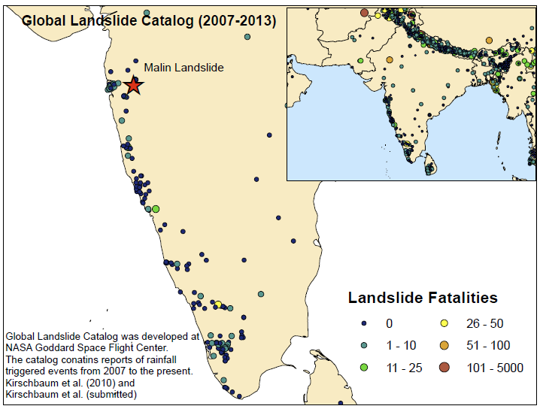
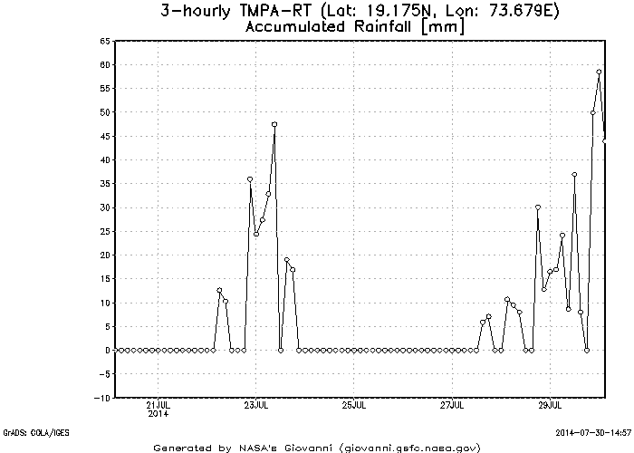
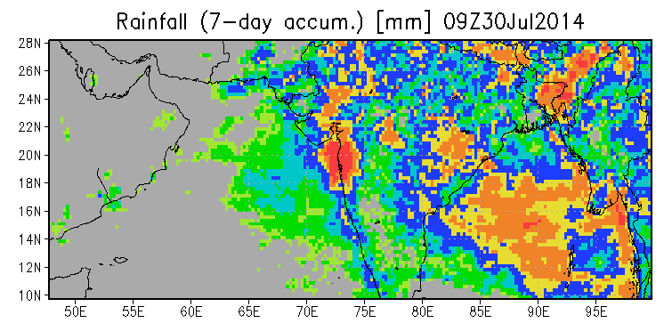
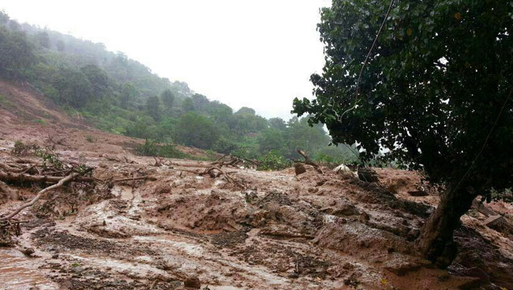
Landslides
Landslide in Malin, Maharashta, India on 7/25/2014. 130 confirmed dead and more are still buried, 44 houses in tribal village crushed. Very heavy monsoon rains contributed to the failure, but even stronger rains were observed by TRMM after the landslide
Indiatoday.intoday.in

Slide 11
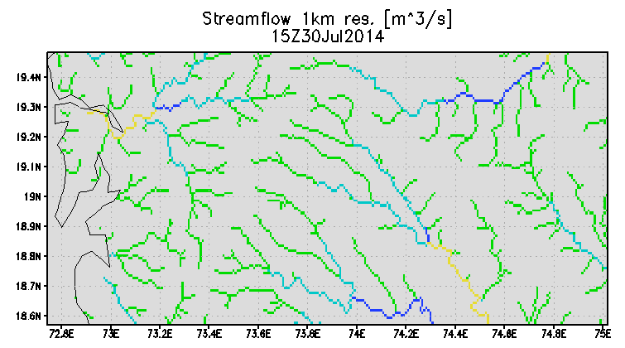
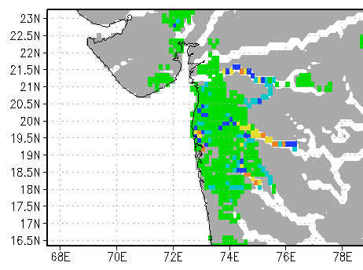


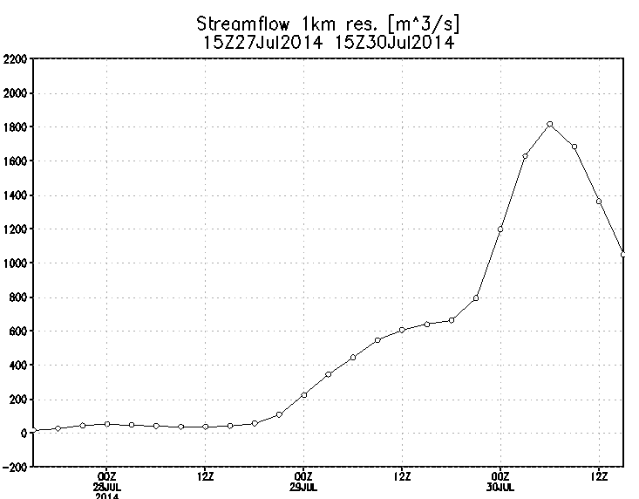
Recent Flooding in India
Landslide Location
X
Downstream from landslide location along crest of Ghats indicates huge jump in streamflow (1 km resolution) up to 1800 m³/s
Adler/Wu U. of Maryland

Slide 12
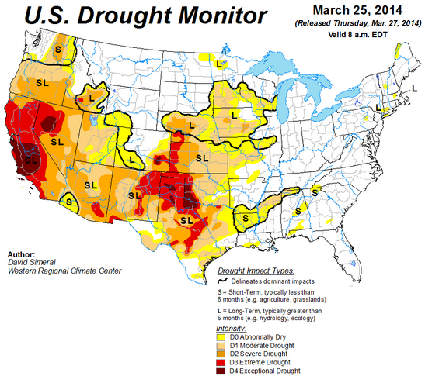
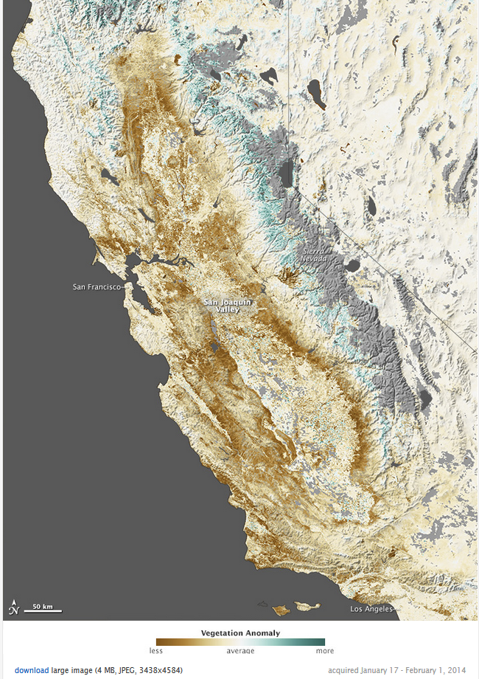

Drought
http://earthobservatory.nasa.gov/
Impact of drought on California based on data from the Moderate Resolution Imaging Spectroradiometer (MODIS) on NASA’s Terra and Aqua satellites, the map contrasts plant health from January 17 to February 1, 2014, against average conditions for the same period over the past decade.
Notes:
Swap for us example – california drought in west

Slide 13
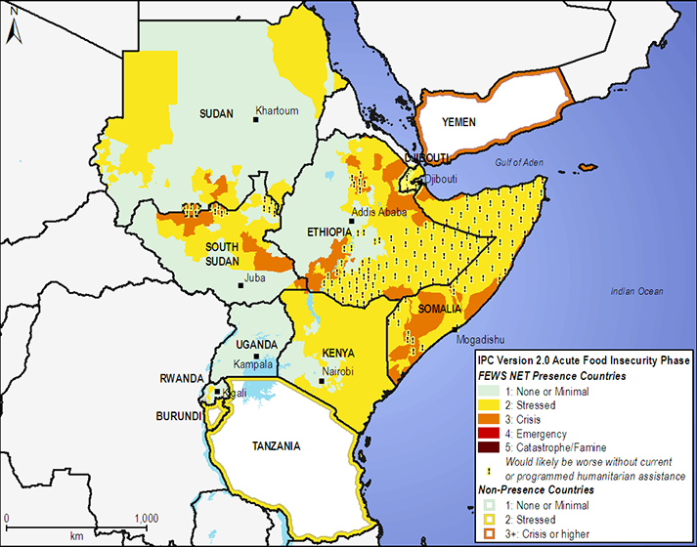
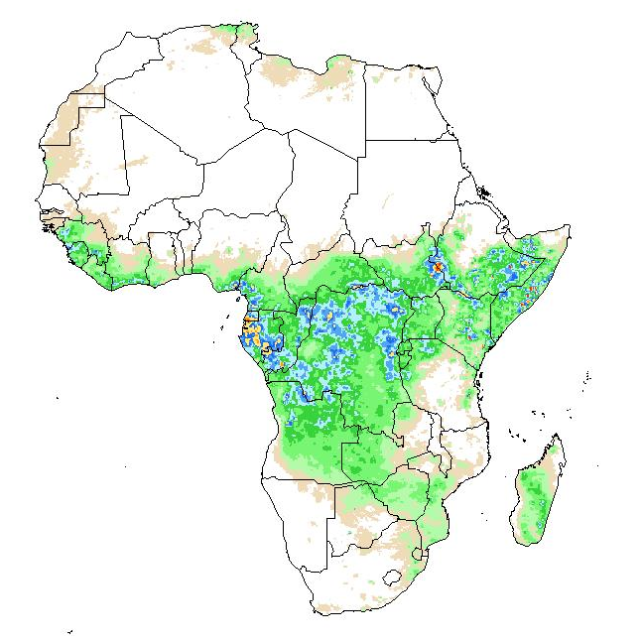
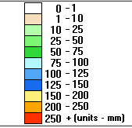
Agricultural Forecasting
Oct-Dec 2012 Outlook
Accurate satellite precipitation estimates are critical to crop forecasts. Famine Earth Warning System (FEWS) relies on satellite precipitation estimates for anticipating poor growing seasons.
http://www.fews.net
Early Warning Explorer (EWX) for browsing time-series rainfall grids, NDVI, LST. http://earlywarning.usgs.gov

Slide 14
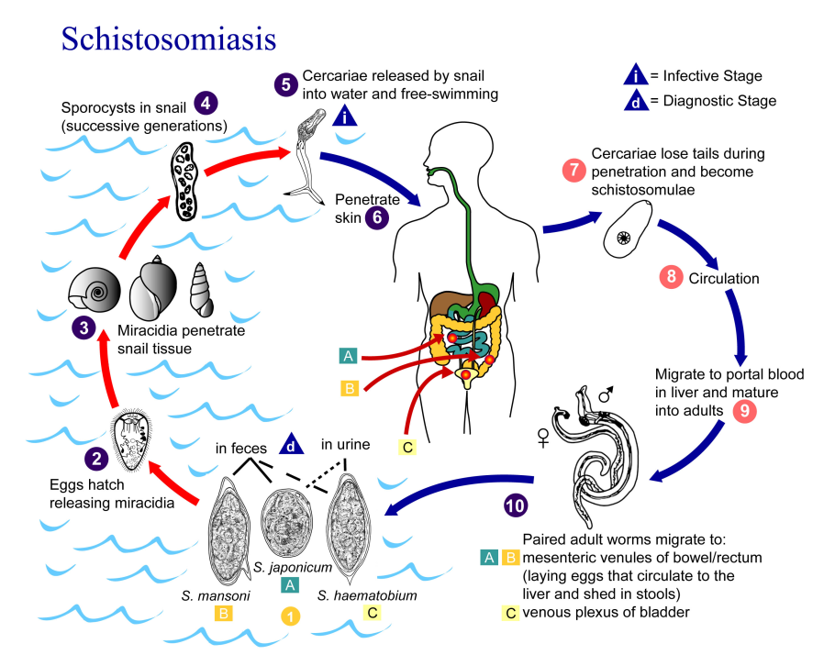
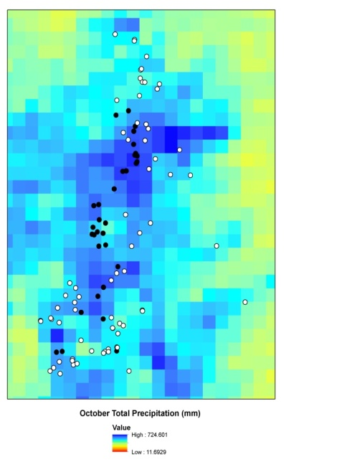
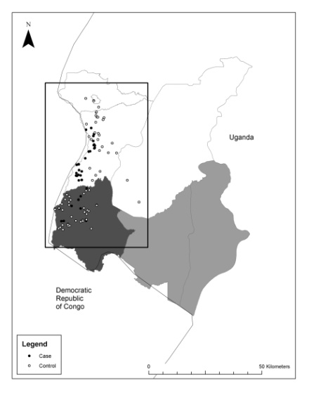
Disease Tracking
Precipitation data has been used to estimate and trace the source areas of vector and river-borne diseases around the world.
Schistosomiasis (snail-spread) in Ethiopia
Observed Plague Cases in Uganda
Courtesy of Bitew and Gebremichael
Studies have found a relationship between satellite rain and the onset of this disease in local populations due to contact with snails in irrigation channels
Cases are associated with wetter, cooler regions
Monaghan et al. 2012; MacMillan et al., 2012

Slide 15
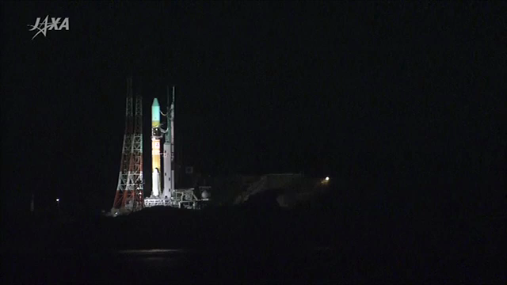
GPM Core Observatory Launch
February 27, 2014. 1:37 p.m. EST
Notes:
Talking points:
Launching on Feb. 27th (1:07 EST), Feb. 28th (3:07 JST) from Tanegashima Space Center in southern Japan
Launching on an H-IIA rocket
Launch to spacecraft separation is 15 minutes
Instruments are turned on within a week and begin the checkout and calibration phases
First data is provided shortly thereafter
GPM will provide data to the public within 6 months of launch
Like all NASA products, GPM data will be shared openly and freely with a broad community of scientific and applications users around the world and thus serve the needs of scientists and agencies all around the world in their efforts.
Launch coverage during the day of launch will be live on NASA TV

Slide 16
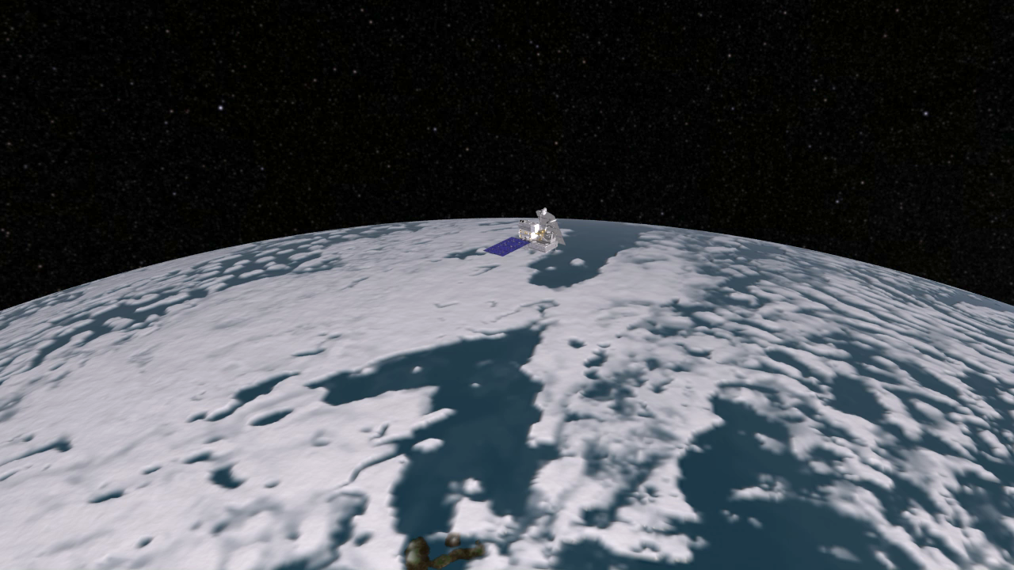
The GPM Core Observatory
Notes:
Talking points:
Two new instruments onboard GPM designed to advance key science questions, technology and societal benefits:
3-D profiling of precipitation from a Dual-frequency Precipitation Radar (DPR, provided by JAXA) - (similar to a CAT-scan)
GPM Microwave Imager (GMI, developed by Ball Aerospace in contract with NASA), radiometer (like an x-ray)
These two instruments will be used to diagnose the intensity and distribution of rain and ice in storms and all types of precipitation around the globe
The instruments can see individual droplets and the distribution of them in the atmospheric column, providing important data to weather and climate models
GPM represents a significant international partnership with Japan, and builds on more than two decades of cooperation that go back before the launch of TRMM (1997) and include a variety of other satellites.
This is an outstanding example of successful international cooperation and working together to achieve important scientific and societal missions.
It also demonstrates the power of our ability to harness the talents of industry, NASA centers, academia, and our interagency partners to do something so important, so challenging, and so well.

Slide 17
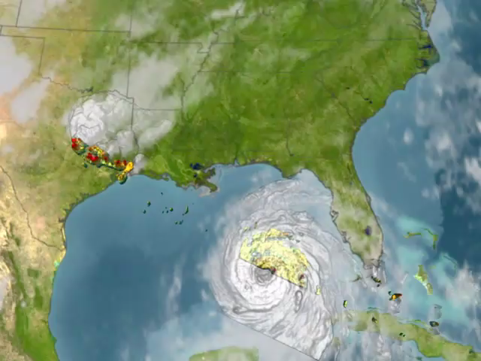
Severe Storms
Notes:
Talking points:
Example from Hurricane Katrina showing hot towers, structures that suggest a storm may intensify
TRMM was the first satellite to see these, In 2004, more than 600 tropical cyclone fixes were made using TRMM.
TRMM data are used by many tropical cyclone forecasting centers worldwide to detect the location and intensity of tropical cyclones.
GPM will be able to observe these structures as storms transition from tropical to extra-tropical systems, such as Sandy, and provide hurricane forecasters with the important tools to forecast storm tracks and make the necessary evacuations.

Slide 18
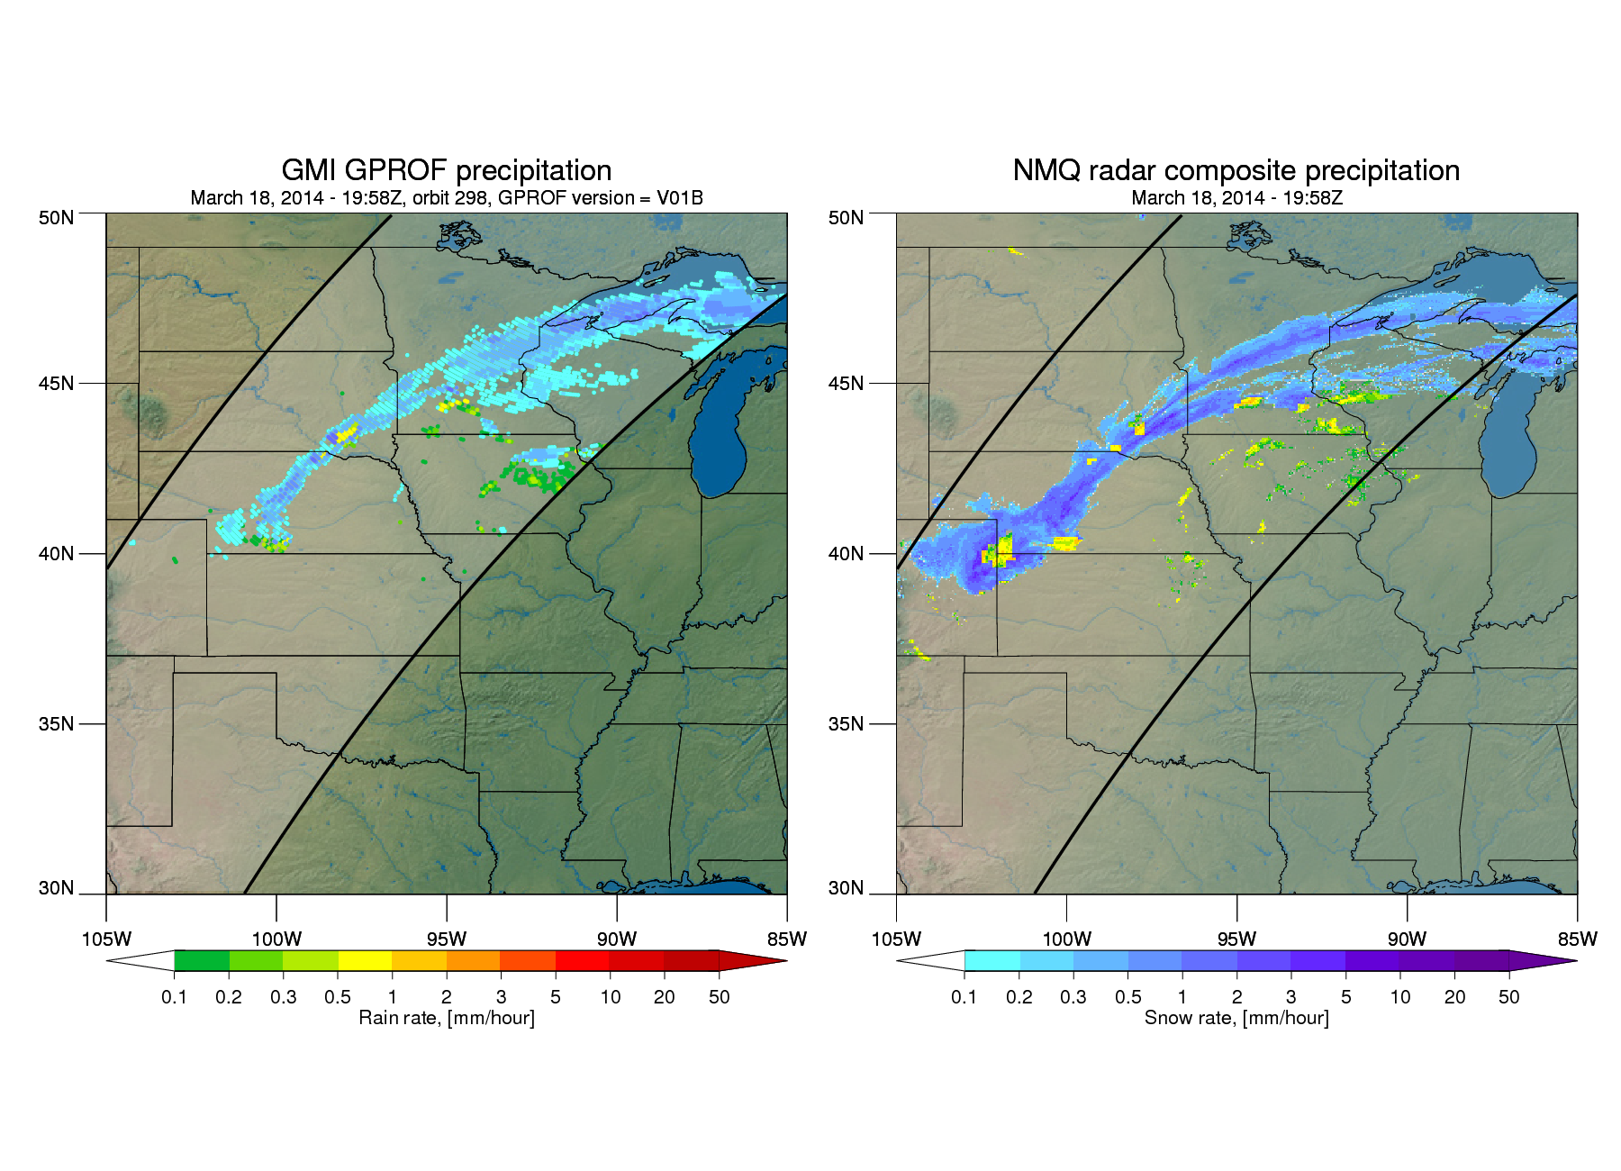
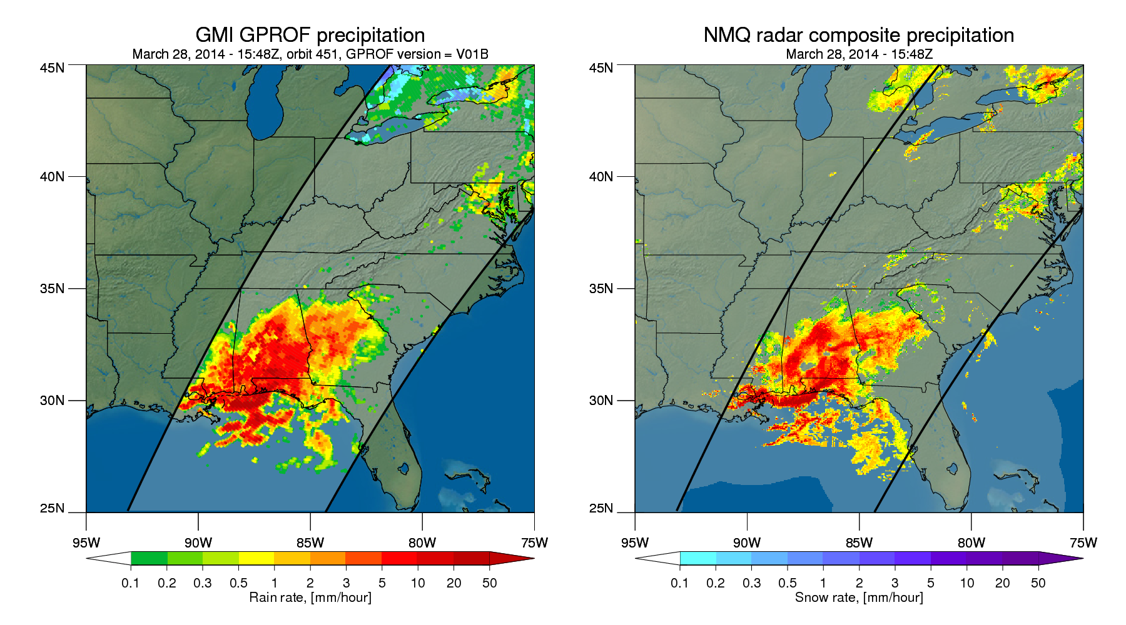
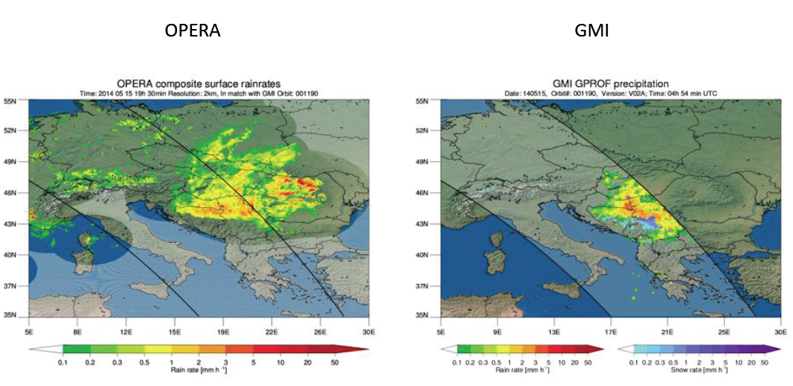
GPM GMI Rainfall Retrieval
Notes:
Data will be released by August 30.

Slide 19
Summary
All nations measure precipitation to the best of their ability.
Weather prediction
Agriculture
Flood prediction as well as recovery efforts
Drought relief efforts
Disease outbreaks
Satellites have a unique role to play in filling the gaps that exist with surface networks.
Notes:
Data will be released by August 30.

